Slide 1
Atomwise Library Screening for multi-targeting Mur ligase inhibitors
13th September, 2022
Anita Catherwood, Julie Tod, Laura Diaz Saez, Christopher Dowson
School of Life Sciences, University of Warwick

Slide 2
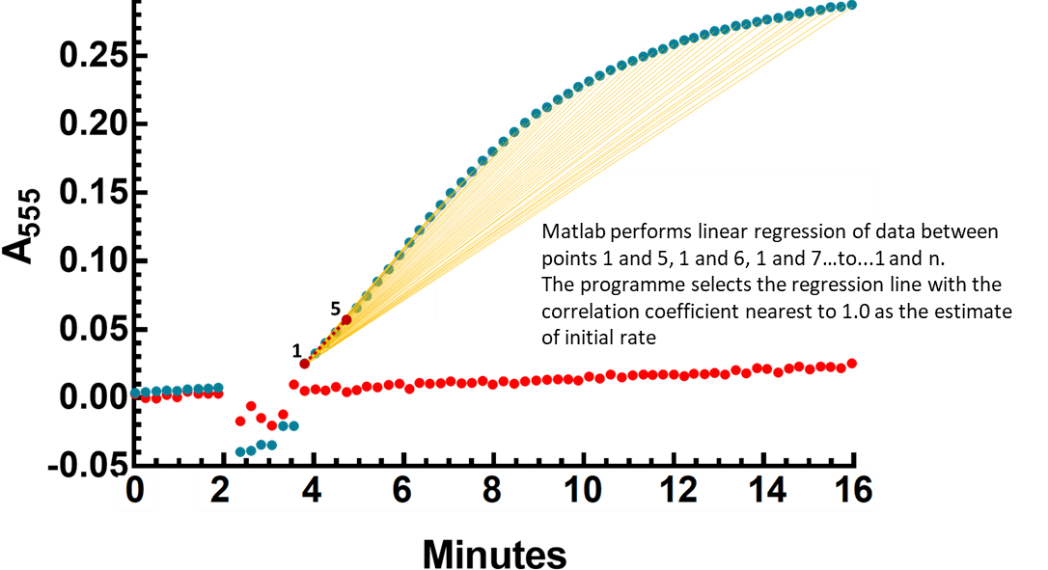
Dealing with the rate limiting step of screening continuous assay data
Manually Interpreted Data
Matlab-automated interpretation of Data
(Auth: Hector Newman)
1) Data (controls and complete reactions) (~100-200 data points per well, four control wells and four complete assay wells per compound) are re-tabulated, and initial rates manually extracted by linear regression of a visually selected linear region of the time course.
2) Initial rates from controls are averaged and the average subtracted from complete reactions
Analysis of 20 compounds in this manner takes 1-2 days of analysis.
Matlab automatically performs steps 1 and 2 using the entire time course of data (or between those time points we wish to analyse:
Complete Assay
Control
Analysis of 20 compounds in this manner takes 1-2 hours of analysis.

Slide 3
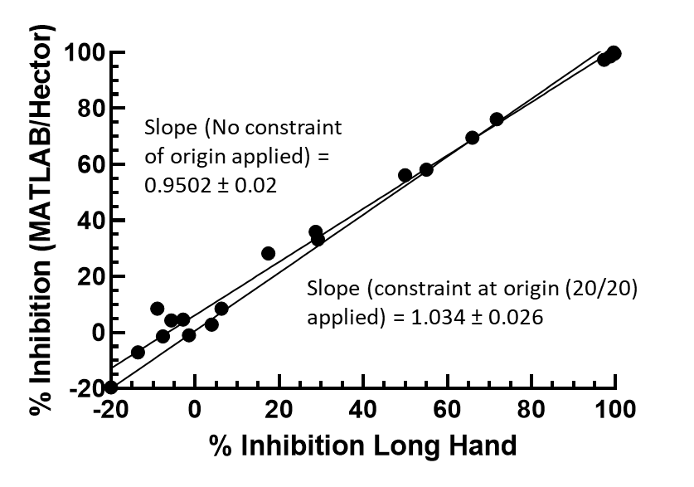
Comparison of Interpretation of Anita’s long hand Excel and Hector/Julie’s Matlab Interpretation of the impact of Atomwise Compounds AW 23-45
In short, Matlab and manual interpretation of data appear to generate comparable results

Slide 4
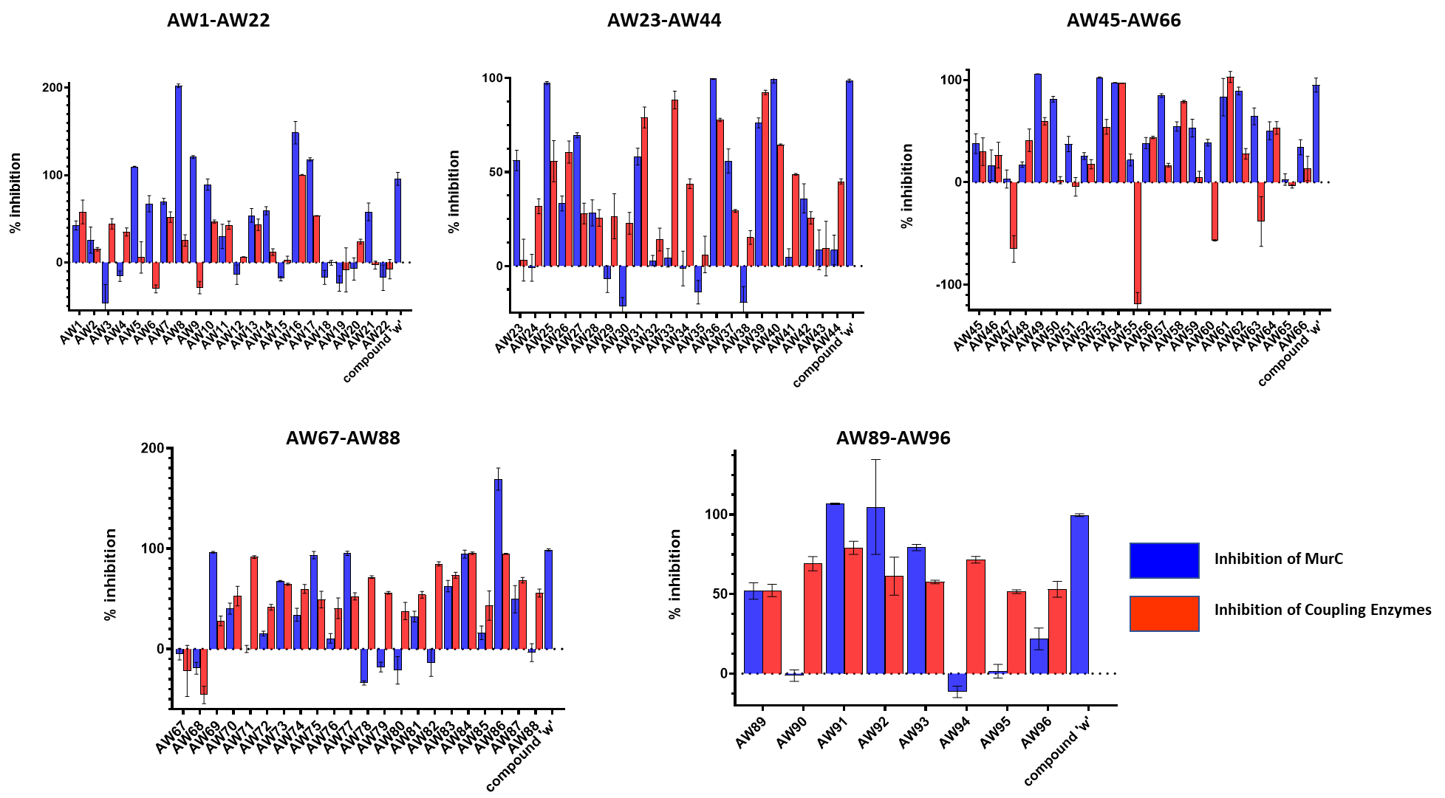
Screening of the Atomwise Library at 1 mM vs. P. aeruginosa MurC
[MurC] = 400 nM, L-Ala = 0.2 mM, UDP MurNAc = 0.1 mM, ATP = 60 μM
[AW__] = 1 mM; [Compound W] = 10 μM

Slide 5
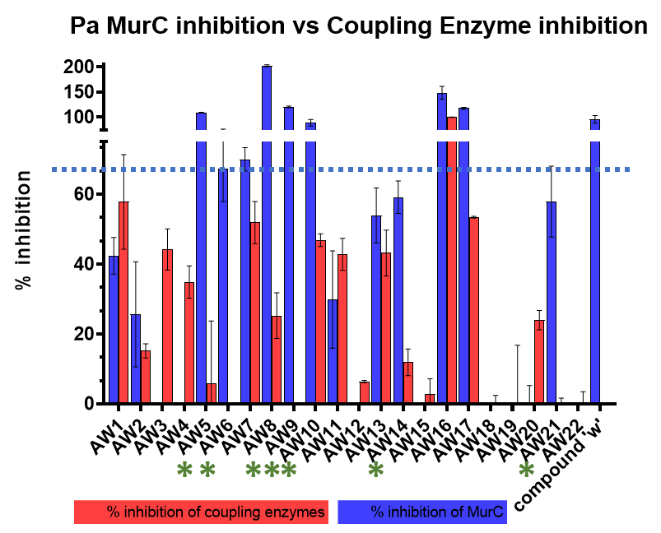
Triaging P. aeruginosa MurC Atomwise data
Therefore coupling enzyme inhibition below 40% will not impact on diagnosis of Mur ligase inhibition
Compound quenching of fluorescence
MurC Atomwise compound inhibitors with >70% inhibition with negligible coupling enzyme activity
Addition of a 100 μM H₂O₂ to assays to generate the fluorescent resorufin signal in the presence of 1 mM compound indicated that none of the Atomwise compounds diminished the final fluorescence signal of of the assay suggesting that the issue of quenching could be discounted.
AW5 | AW49 | AW69
AW8 | AW50 | AW75
AW9 | AW53 | AW77
AW10 | AW57 | AW92
AW17 | AW62 | AW93
AW25

Slide 6
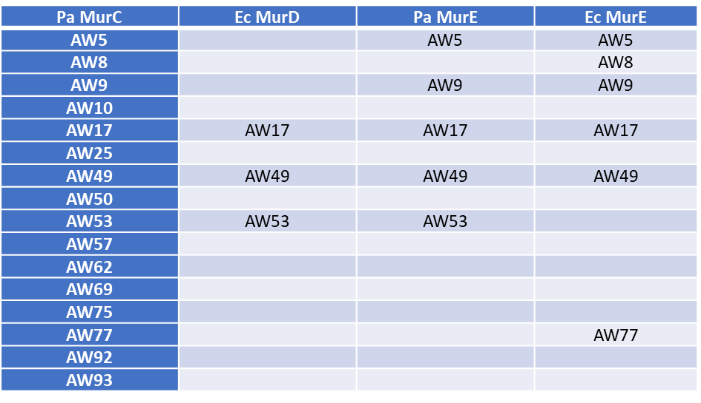
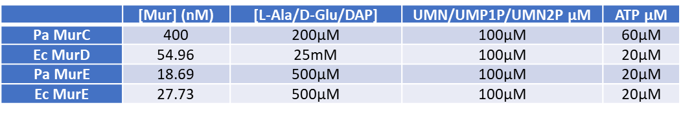
Trialling P. aeruginosa MurC Atomwise hits vs. E. coli MurD and E and P. aeruginosa MurE
E. coli MurD screened with P. aeruginosa MurC hits
Atomwise compounds showing > 70% inhibition at 1mM
Also Pa MurE and Ec MurE
Of the 16 MurC hits in the AW library, 9 singly targeted, 2 doubly targeted, 3 triply targeted and 2 quadruply targeted MurC, D or E (both).
The IC₅₀ values were then established for AW17, 49 and 53 (Other compounds in progress).
Substrate and Mur Ligase Assay Concentrations

Slide 7
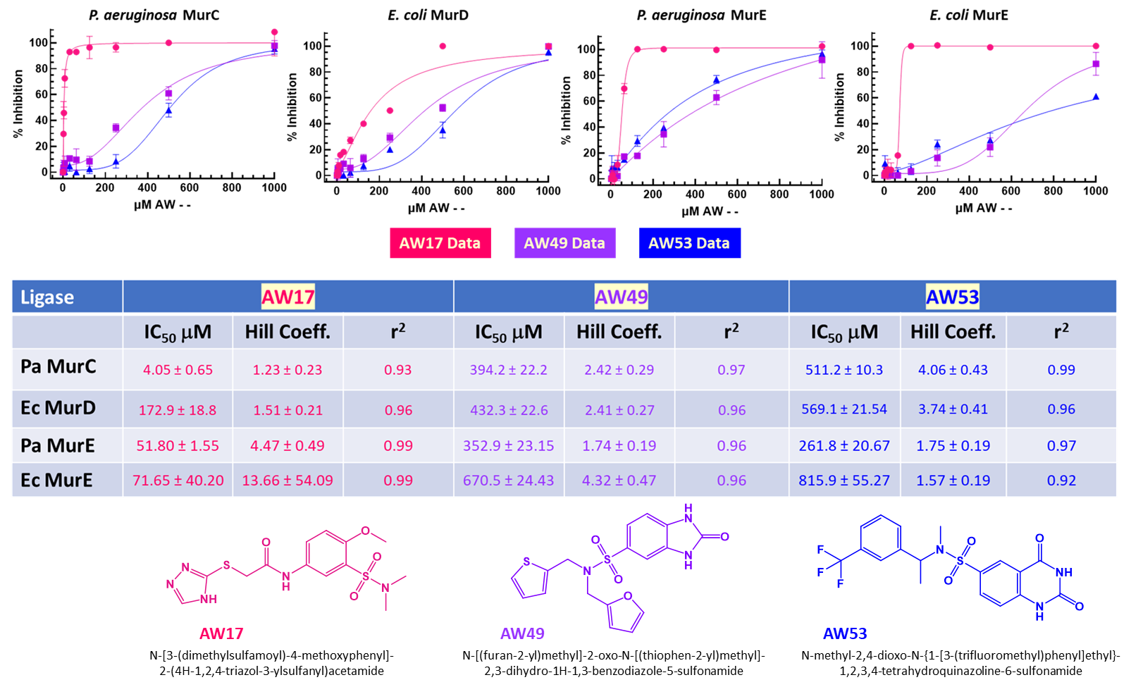
IC₅₀ Data of multi-ligase targeting Atomwise Compounds

